Slide 1

Claims & Remits EDW
Teradata to BigQuery Migration

Slide 2
Redesigned Workflows

Slide 3
Claims Export Process
BAM Start Activity
Reset TD Staging Tables
Update SQL Fact Tables
Build SQL DW Master Tables
Existing Workflow
On Premises
Load TD Staging Tables
Completion Status Trace
CleanUp SQL Staging Tables
BAM End Activity
Upsert TD Core Tables
BAM Start Activity
Update SQL Fact Tables
Build SQL DW Master Tables
Create Done File
Check for Done Files
Reset BQ Staging Tables
Proposed Workflow
On Premises
GCP
Load BQ Staging Tables
Completion Status Trace
CleanUp SQL Staging Tables
BAM End Activity
Check for Reverse Done Files
Create Reverse Done File
Upsert BQ Core Tables
Teradata
BigQuery
SQL Server
Files / Others

Slide 4
Remits Export Process
Initialize
Reset TD Staging Tables
Load TD Staging Tables
Existing Workflow
On Premises
Upsert TD Core Tables
CleanUp SQL Staging Tables
File Updates
Claim Updates
Initialize
Create Done File
Check for Done Files
Reset BQ Staging Tables
Proposed Workflow
On Premises
GCP
Load BQ Staging Tables
CleanUp SQL Staging Tables
File Updates
Claim Updates
Check for Reverse Done Files
Create Reverse Done File
Upsert BQ Core Tables
Teradata
BigQuery
SQL Server

Slide 5
EP Payor Recon Export Process
Purge SQL StagingTables
Load Recon Staging Table
Update Recon for Unit # & IPlan
Load SQL Unit Mstr Staging Table
Reset TD Staging Tables
Records > 0
Zero Records
No Input File
Existing Workflow
On Premises
Load TD Staging Tables
Archive & Purge Daily PDFs
Create Onbase Index for SSCs
Upsert TD Core Tables
Records > 0
Purge SQL StagingTables
Load Recon Staging Table
Update Recon for Unit # & IPlan
Create Done File
Check for Done Files
Reset BQ Staging Tables
Zero Records
Proposed Workflow
On Premises
No Input File
GCP
Load BQ Staging Tables
Archive & Purge Daily PDFs
Create Onbase Index for SSCs
Load Unit Mstr Staging Table
Check for Reverse Done File
Create Reverse Done File
Upsert BQ Core Tables
Teradata
BigQuery
SQL Server
Files / Others

Slide 6
GCP Implementation

Slide 7












GCP Architecture
Cloud IAM Security & Access Management
GCP Projects
CONSUMPTION & REPORTING
LANDING PROJECT
PROCESSING PROJECT
CURATED PROJECT
EXT. SOURCE DATA
Raw data landing zone
(if necessary)
Orchestration and data processing services
Cleaned and transformed data served
Composer
Power BI
Dataflow
BigQuery
Cloud
Storage
Secrets
Manager
claims
N/A
OUTBOUND
remits
MONITORING DASHBOARDS
GCP Logging and Monitoring Project
Alerting via PagerDuty and Webex
Log Sinks to BigQuery

Slide 8
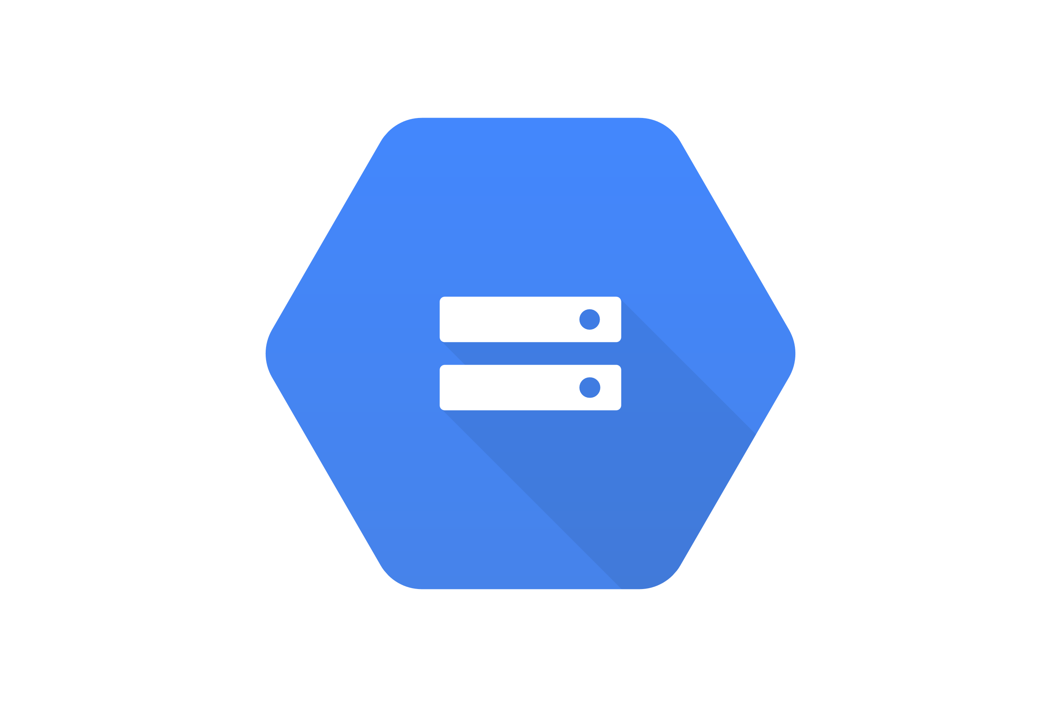





Ingest Workflow
Storage
Cloud Storage
Optional Checks
Load Process
Optional
Truncate Tables
Check Done File
Start
DAG
Trigger Dataflow Job
Reverse Done File
End
DAG
Orchestration
Cloud Composer
Sensor – Other DAG Completion
DAG Code
Templates
Wait for Completion
LOB Config
Source SQLs
Ingest Info
File Layouts
Cloud Datawarehouse
BigQuery
Data Pipeline
Cloud Dataflow
LOB Staging Tables

Slide 9
Integration Workflow
Storage
Cloud Storage
Optional Checks
Load Process
Optional
Check Done File
Run Work & Core Load Scripts
Start
DAG
Reverse Done File
End
DAG
Orchestration
Cloud Composer
Sensor – Other DAG Completion
Run Audit Scripts
DAG Code
Templates
LOB Config
Pipeline Info
LOB
Core, Work & Audit Tables
Cloud DW
BigQuery

Slide 10
Appendix

Slide 11
GCP Master Architecture
The link below refers to the Master GCP Architecture document created for HCA's Teradata Migration Project.
The document covers overall design principles, ingestion patterns, alerting, and code repository setup for the GCP platform.
HCA Healthcare - GCP Master Architecture.docx
The remainder of this presentation covers LOB-specific architecture in greater detail.

